Slide 1
Chapter
RELATIONS

Slide 2
5. Relations
5.1 Relations and Their Properties
5.2 Representing Relations
5.3 Equivalent Relations. Congruences. Arithmetic Operations on Z_{n}
5.4 Partial Orderings. Hasse Diagram

Slide 3
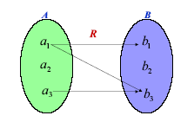
5.1.1 Definitions
Definition. A binary relation from a set A to a set B is a subset of the Cartesian (Cross) Product: R ⊆ A x B.
Notation: a R b
R = { (a₁, b₁), (a₁, b₃), (a₃, b₃) }

Slide 4
Example. Let A = {1, 2, 3, 4}, and
R = {(a, b) ∈ A×A | a divides b}
Then R consists of the pairs:
R = {(1, 1), (1, 2), (1, 3), (1, 4), (2, 2), (2, 4), (3, 3), (4,4)}
1
2
3
4
1
2
3
4

Slide 5
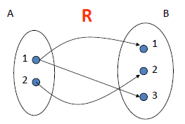
Example: Let A = {1; 2} and B = {1; 2; 3},
and the relation is given by
(x; y) ∈ R ⇔ x - y is even.

Slide 6
2. Properties of Relations
Let R be a relation on A
1) Reflexive : (a, a) ∈ R for all a ∈ A
2) Symmetric : ∀ a, b∈ A , (a R b) → (b R a)
3) Antisymmetric :
∀ a, b ∈ A, (a R b) ∧ (b R a) → (a = b)
4) Transitive :
∀a,b,c ∈ A, (a R b) ∧ (b R c) → (a R c)
Example.
The relation ≤ on Z is not symmetric.
However it is antisymmetric, reflexive.

Slide 7
3. Representing Matrix of Relation
A = {a₁, a₂, …, a_{m}} , B = {b₁, b₂, …, b_{n}},
The representing matrix of R ⊂ A x B:
M_{R} = [m_{ij}] m × n matrix
0 if (a_{i} , b_{j}) ∉ R
1 if (a_{i} , b_{j}) ∈ R
m_{ij} =
R be a relation on a set A, then the matrix M_{R} that represents R is a square matrix
 | 1 | 2
1 | 0 | 0
2 | 1 | 0
3 | 1 | 1
Example. Let R be the relation from A = {1, 2, 3} to B = {1, 2} such that a R b if a > b.
Then the representing matrix of R is

Slide 8
R is reflexive if and only if all diagonal entries of M_{R} are equal to 1: m_{ii} = 1 for all i
 | u | v | w
u | 1 | 1 | 0
v | 0 | 1 | 1
w | 0 | 0 | 1
R is antisymmetric if and only if M_{R} satisfies:
m_{ij} = 0 or m_{ji} = 0 if i ≠ j
 | u | v | w
u | 1 | 0 | 1
v | 0 | 0 | 0
w | 0 | 1 | 1

Slide 9
Let R be a relation on a set A, then the matrix M_{R} that represents R is a square matrix
R is symmetric if and only if M_{R} is symmetric
m_{ij} = m_{ji} for all i, j
 | u | v | w
u | 1 | 0 | 1
v | 0 | 0 | 1
w | 1 | 1 | 0

Slide 10
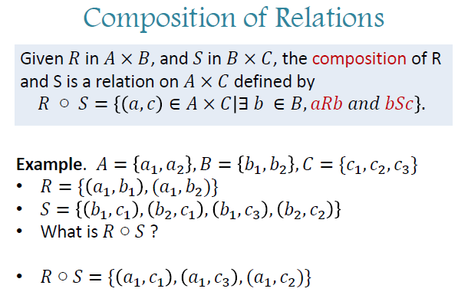

Slide 11
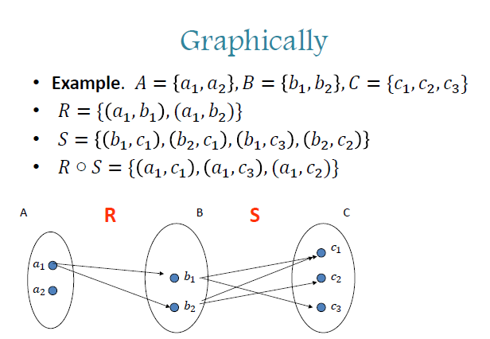

Slide 12
Definition. Let A = [a_{ij}] be an m × n zero-one matrix and B = [b_{jk}] be an n × p zero-one matrix.
Then the Boolean product A  B = [c_{ik}] is the m × p zero-one matrix defined by
c_{ik} = (a_{i1} ∧ b_{1k}) ∨ (a_{i2} ∧ b_{2k}) ∨ … ∨ (a_{in} ∧ b_{nk})
for 1 ≤ i ≤ m , 1 ≤ k ≤ p
Note. The ( i, k)^{th} entry of A  B is obtained by:
carrying out the AND operator to every element of the i^{th} row of the matrix A to the corresponding element of the k^{th} column of B,
then take the OR operator on n obtained results

Slide 13
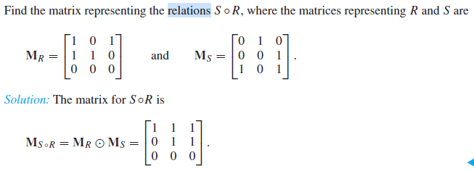
Theorem. The representing matrix M_{S o R} of the relation S ° R is precisely the matrix M_{R}  M_{S} = [t_{ik}], where
t_{ik} = (r_{i1} ∧ s_{1k}) ∨ (r_{i2} ∧ s_{2k}) ∨ … ∨ (r_{in} ∧ s_{nk})
for 1 ≤ i ≤ m , 1 ≤ k ≤ n
Example:

Slide 14
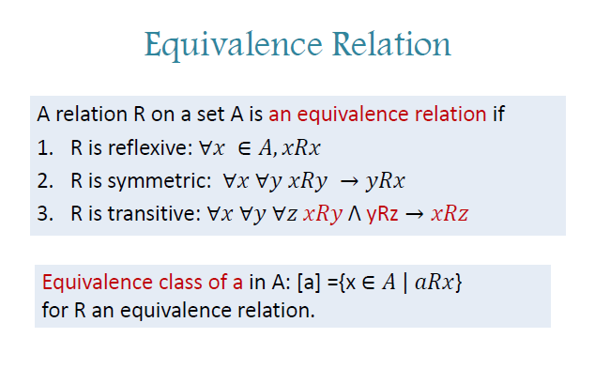

Slide 15
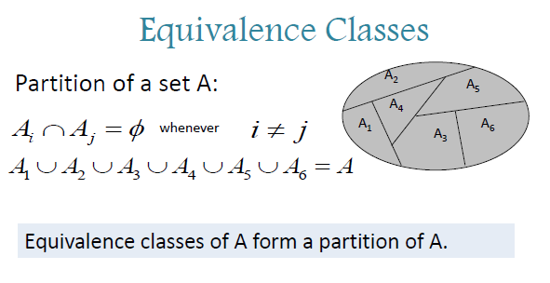

Slide 16
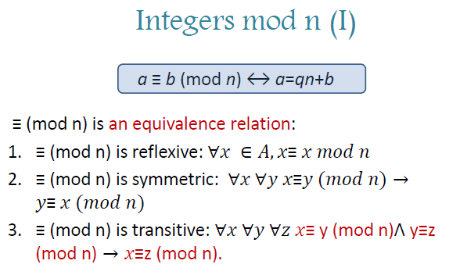

Slide 17
Partial order
Definition. A relation R on a set A is a partial order if it is reflexive, antisymmetric and transitive.
We often denote a partial order by
The pair (A, ) is called a partially ordered set or a poset
Reflexive: a a
Antisymmetric: (a b) ∧ (b a) → (a = b)
Transitive: (a b) ∧ (b c) → (a c)

Slide 18
Definition. A relation R on a set A is a partial order if it is reflexive, antisymmetric and transitive.
Example. The divisibility relation “ | “on the set of positive integers is a partial ordering, i.e. (Z⁺, | ) is a poset
Reflexive?
Yes, x | x since x = 1 ⋅ x
Transitive?
Yes?
a | b means b = ka, b | c means c = jb. Then c = j(ka) = jka: a | c

Slide 19
Example. The divisibility relation “ | “on the set of positive integers is a partial ordering, i.e. (Z⁺, | ) is a poset
Antisymmetric?
Yes?
a | b means b = ka, b | a means a = jb. Then a = jka
It follows that j = k = 1, i.e. a = b
Example. Is (Z, | ) a poset?
Not a poset.
Antisymmetric?
3|-3, and -3|3,
but 3 ≠ -3.
No

Slide 20
Ex. Is (2^{S}, ⊆ ), where 2^{S} the set of all subsets of S, a poset?
Yes, A poset.
Reflexive?
Yes, A ⊆ A, ∀A∈ 2^{S}
Transitive?
A ⊆ B, B ⊆ C. Does that mean A ⊆ C?
Yes
Antisymmetric?
A ⊆ B, B ⊆ A. Does that mean A =B?
Yes

Slide 21
Definition. Let (S, ) be a poset. Let a and b are elements of S. If a b then we say that b is an upper bound of a and a is a lower bound of b.
The elements a and b are said to be comparable if either a is a lower bound of b or b is a lower bound of a.
Otherwise, they are said to be incomparable.
A poset (S, ) such that every two elements are comparable is called a totally ordered set
We also say that is a total order or a linear order on S
Example. The relation “≤ “ on the set of positive integers is a total order.

Slide 22
The elements a and b are comparable if either a is a lower bound of b or b is a lower bound of a.
Otherwise, they are incomparable.
A poset (S, ) such that every two elements are comparable is called a totally ordered set
We also say that is a total order or a linear order on S
Example. The divisibility relation “ | “on the set of positive integers is not a total order,
since the elements 5 and 7 are not comparable

Slide 23
Hasse Diagrams
A poset can be represented visually using a special kind of graphs called the Hasse diagram
To define the Hasse diagram we need the concept of direct upper bound.
Definition. An element b in a poset (S, ) is said to be a direct upper bound of an element a in S if
b is an upper bound of a, and there is no upper bound c of a such that

Slide 24
Hasse Diagrams
Now the Hasse diagram of a finite poset (S, ) is the graph:
whose vertices are points in the plane in one-to-one correspondence with S,
two vertices a, b are joined by an arc directed from a to b if b is a direct upper bound of a
b
d
a
e
c

Slide 25
Hasse Diagrams
Ex. The Hasse diagram of the poset ({1,2,3,4}, ≤) can be drawn as
4
Note. We did not draw up arrows for the arcs by adopting the convention that arcs are always directed upward
3
2
1

Slide 26
Example. The Hasse diagram of P({a,b,c})
and the Hasse diagram of the set of bit strings of length 3 with natural bitwise order
{a,b,c}
111
{a,b}
{b,c}
{a,c}
011
110
101
{a}
{b}
{c}
100
010
001
∅
000
They look similar !!!

Slide 27
Maximal & Minimal Elements
Consider this poset:
Each Red is maximal: there is no proper upper bound
Each Green is minimal: there is no proper lower bound
There is no arc starting from a maximal element
There is no arc ending at a minimal element

Slide 28
Note. In a finite poset S, maximal and minimal elements always exist.
In fact, we can start from any element a₀ ∈ S.
If a₀ was not minimal, then there exists a₁ a₀,
and so on until a minimal element is found.
The maximal elements are found in a similar way.
a₀
a₁
a₂

Slide 29
Example. What are the maximal and minimal elements of the poset ({2, 4, 5, 10, 12, 20, 25}, | ) ?
Solution. From the Hasse diagram, we see that 12, 20, 25 are maximal elements
and 2, 5 are minimal elements
Thus the maximal and minimal elements of a poset are not necessarily unique
12
20
10
4
25
2
5

Slide 30
In fact we have
Theorem. In a finite poset, if the maximal element is unique, then it is the greatest element .
Similarly for the least element.
Proof. Let g be the unique maximal element.
m
g
Let a be an arbitrary element, then
there is a maximal element m such that
a m
a
Since g is unique we must have m = g , i.e. a g
l
Therefore g is the greatest element.
Similar proof for the existence of the least element l

Slide 31
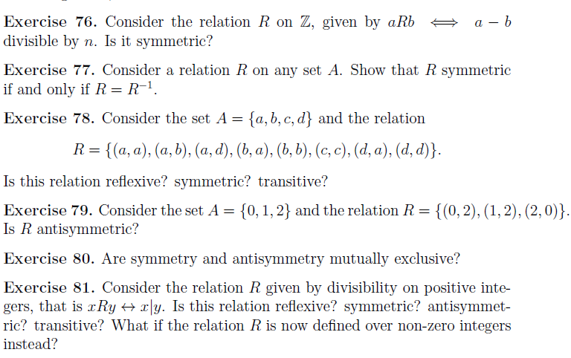

Slide 32
